Slide 1
NATURAL LANGUAGE PROCESSING
Final Project
Artificial Intelligence
Dr. Butler | Fall 2017
Benjamin Garlington
Ciji Ramos
Jamoris Miller
Mariana Carvalho
Mohiuddin Hasan
Robin Ghosh

Slide 2
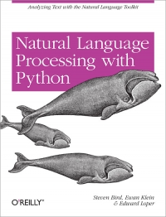
WHAT IS NATURAL LANGUAGE PROCESSING (NLP)?
“By natural language we mean a language that is used for everyday communication by humans; languages such as English, Hindi, or Portuguese. We will take Natural Language Processing in a wide sense to cover any kind of computer manipulation of natural language. At one extreme, it could be as simple as counting word frequencies to compare different writing styles. At the other extreme, NLP involves “understanding” complete human utterances, at least to the extent of being able to give useful responses to them”.
Steven Bird, Ewan Klein, and Edward Loper
Natural Language Processing with Python
Notes:
Definition of Natural Language Processing (NLP)

Slide 3
SO, NLP IS…
…a branch of computational linguistics, artificial intelligence and computer science that handles the analysis of the language that humans use naturally (in everyday speech) in order to connect with computers and machines in both written and spoken contexts.

Slide 4

Notes:
Video NLP

Slide 5
TERMINOLOGY
Automatic Speech Recognition vs NLP vs Natural Language Understanding
Automatic Speech Recognition (ASR)
NLP
Named Entity Recognition (NER)
NLU
Summarization
Paraphrase & Natural Language Inference
Part-of-speech tagging (POS)
Syntactic parsing
Coreference resolution
Relation extraction
Sentiment Analysis
Semantic Parsing
Text categorization
Machine translation
Dialogue Agents
Text-to-Speech(TTS)
Question answering(QA)
Source: https://nlp.stanford.edu/~wcmac/#papers
Notes:
NLU can be seen as a subfield of NLP. NLP englobes all techniques used for parsing text and extracting some knowledge about it. It could be finding out what are the common entities in the text, calculating the likelihood of a certain word being a preposition or a verb, sentiment analysis, or even spell checking sentences.
When you are processing a language, it does not mean you are understanding the language. You may simply have rules, statistics, or some heuristics built to extract the information you need for some work. NLU, on the other hand, implies that a system will try to understand the text.

Slide 6
THE COMPLEXITY OF NLP
Human Language and Communication is rarely precise. When we try to understand human language, it is not just about the words, but also the concepts and how the words are linked together, bringing a meaning to the sentence and context.
The ambiguity of understanding the human language makes NLP a complex problem for computers to process.

Slide 7
THE IMPORTANCE OF NLP
NLP can perform tasks such as:
automatic summarization
translation
named entity recognition
relationship extraction
sentiment analysis
speech recognition
topic segmentation
With NLP developers can organize and structure knowledge

Slide 8
THE IMPORTANCE OF NLP
NLP considers:
the hierarchical structure of language: several words make a phrase, several phrases make a sentence and, ultimately, sentences convey idea
LP systems have long filled useful roles, such as correcting grammar, converting speech to text and automatically translating between languages

Slide 9
Task in NLP (Robin)
Segmentation
Stemming
POS Tagging
Named entity Recognition
Sensitivity analysis

Slide 10
Segmentation
Segmentation is the process of splitting a text into segment or sentences..
Text = “The Final Presentation has been scheduled for this Monday. We have a final exam on December 3,2017 ”
Segment #1: The Final Presentation has been scheduled for this Monday
Segment #2: We have a final exam on December 3,2017
Notes:
1. In other words deciding where sentences begin and end.
2. Word segmentation or tokenization means divide the text word by word.

Slide 11
Stemming
Stemming is the process for reducing inflected (or sometimes derived) words to their stem, base or root form.
• car, cars -> car
• run, ran, running -> run
• stemmer, stemming, stemmed -> stem

Slide 12
POS tagging
Part of speech (POS) recognition is the process of marking up a word in a text as corresponding to a particular parts of speech.
“ Today is a beautiful day
Noun Verb Article Adjective Noun
Notes:
DET determiner, article the, a, some, most, every, no, which

Slide 13

Named Entity Recognition
NER is a subtask of information extraction that seeks to locate and classify the named entities in text into predefined categories.
Example :
George saw the New York skyline in the 50’s”
Notes:
such as the names of persons, organizations, locations, expressions of times, quantities, monetary values, percentages, etc.

Slide 14
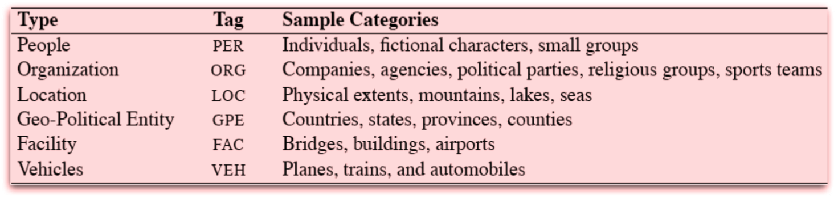
Named Entity Types

Slide 15
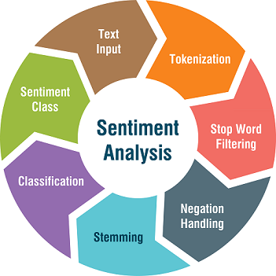
Sentiment analysis
Using NLP, Statistics or machine learning methods to extract, identify or characterize the sentiment content of a text unit.
Notes:
Sometimes referred to as opinion mining, although the emphasis in this case is on extraction.
Negation Modifiers, like word “not” modify the meaning of the associated word. Handling Negation Modifier is important as they may modify the Sentiment conveyed by the associated word. Examples of negation words include not, no, never, cannot, shouldn't, wouldn't, etc.

Slide 16
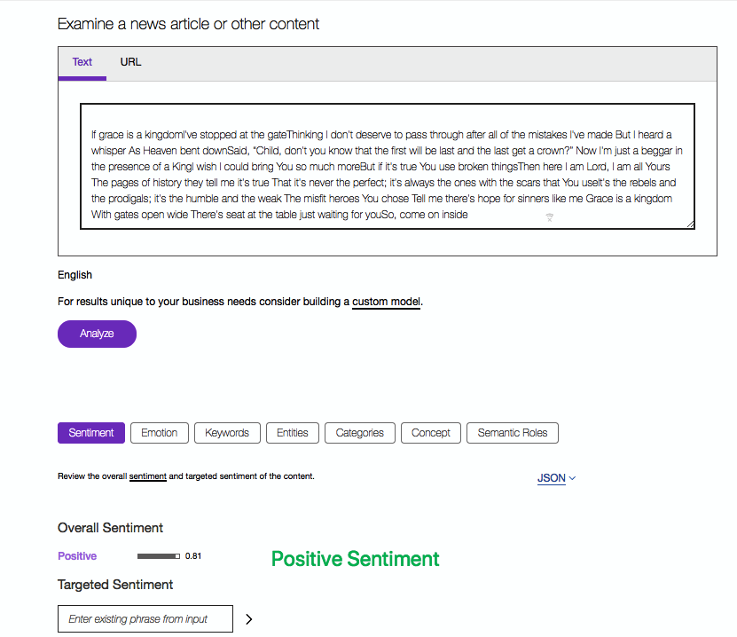
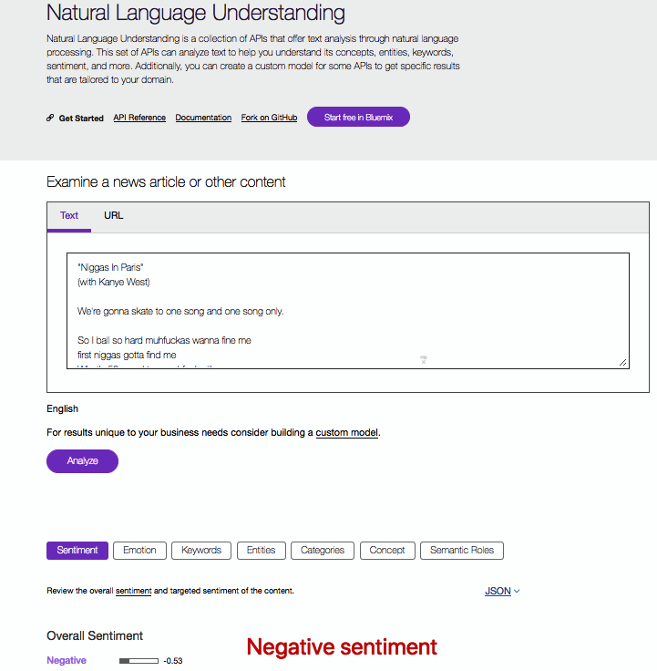
Comparison
Notes:
Demo IBM Watson:
https://natural-language-understanding-demo.ng.bluemix.net/

Slide 17



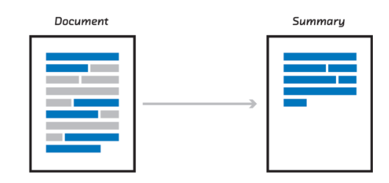
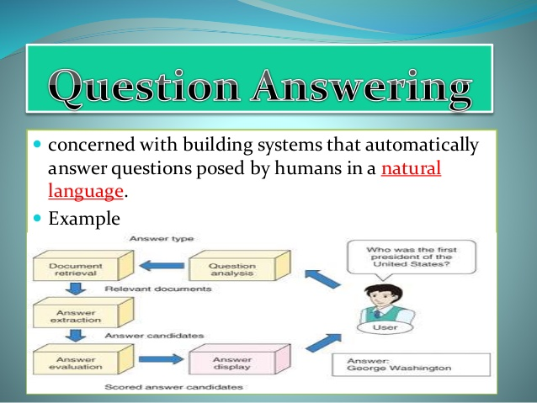
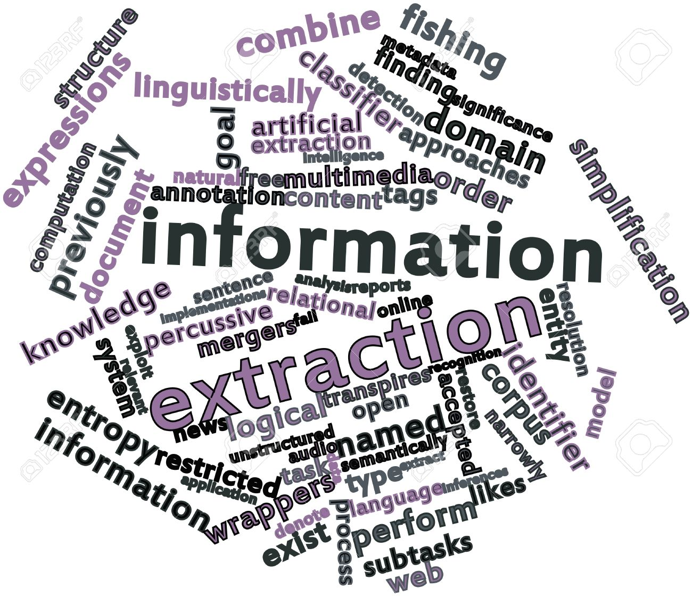
APPLICATIONS
Notes:
IBM Blue Mix
DIFFERENT APPLICATIONS OF NATURAL LANGUAGE PROCESSING:
https://www.lifewire.com/applications-of-natural-language-processing-technology-2495544
machine translation (All of the world's information is online now how to make it accessible to everyone, across language barriers.google is at the forefront of machine translation, using a proprietary statistical engine for its google translation service. The challenge is not translating the words but the preserving the meaning of sentences, a complex technological issue that is at the heart of NLP.)
fighting spam (spam filters is another important application of NLP to detect unwanted email but user face sometimes problem that important mails have been accidently caught in the filter which is another challenge of NLP to fight with false positive and false negative issues. Now a days Bayesian spam filtering has received much attention, in which the incidence of a word in email is measured against its typical occurrence in a corpus of spam and non spam emails.)
information extraction( Algorithmic trading is more important nowadays like thing are moving from human oversight and control.But many of these financial decisions are impacted by news, by journalism which is still presented predominantly in English.For example, news of a merger between companies can have a big impact on trading decisions, and the speed at which the particulars of the merger, players, prices, who acquires who, can be incorporated into a trading algorithm can have profit implications in the millions of dollars.
summarization (Information overload is a real phenomenon in our digital age. an ability to summarize the meaning of documents and information is becoming increasingly important.for example, based on aggregated data from social media, can a company determine the general sentiment for its latest product offering? This branch of NLP will become increasingly useful as a valuable marketing asset. )
Question Answering (Search engine puts lot of information at our fingerprint. A big focus of Google's efforts in NLP has been to recognize natural language questions, extract the meaning, and provide the answer, and the evolution of Google's results page has shown this focus. Though certainly improving, this remains a major challenge for search engines, and one of the main applications of natural language processing research.)

Slide 18
Source (Robin)
https://www.slideshare.net/pranavgupta21/introduction-to-natural-language-processing-13847262
https://www.slideshare.net/jaganadhg/natural-language-processing-14660849
https://www.slideshare.net/butest/machine-learning-applications-in-nlpppt
https://lct-master.org/files/MullenSentimentCourseSlides.pdf
https://www.lifewire.com/applications-of-natural-language-processing-technology-2495544

Slide 19
Lyrics Analysis
&
Rating System
Notes:
Introduction of our project

Slide 20
Natural Language Processing Libraries
Some NLP libraries:
Apache OpenNLP
Mallet
Natural Language Toolkit (NLTK)
Stanford NLP
TextBlob
gensim

Slide 21
Notes:
Cleaning up the code

Slide 22
Notes:
screenshot

Slide 23
Notes:
Github link

Slide 24
OBJECTIVE
The objective of this project is to create a program capable of analyzing a lyric’s song, identifying its curse words, and rate the song based on the Motion Picture Association of America rating system. In our project, we defined the rating as:
G – General Audience
PG13 – Inappropriate for children below 13 years old
R – Restricted, inappropriate for children below 18 years old
Notes:
Analyze / Identify curse words / Rate

Slide 25
Notes:
Screen short + how the dictionary was created + how do we implement it in our program
WHY WE DO

Slide 26
Notes:
Screenshot
HOW WE DO (count/ percentage)

Slide 27
Visualization
Notes:
explain

Slide 28
Notes:
screenshot

Slide 30
Notes:
Visualization: e.g. inside R, which song has more curse words? Classify by #curse words -> https://matplotlib.org/gallery/shapes_and_collections/marker_path.html#sphx-glr-gallery-shapes-and-collections-marker-path-py
Divided by genres: https://matplotlib.org/gallery/api/unicode_minus.html#sphx-glr-gallery-api-unicode-minus-py

Slide 31
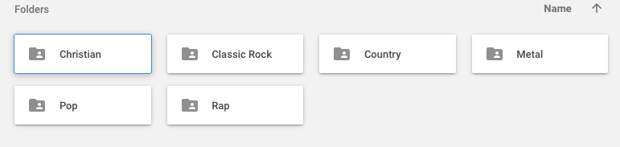
OUR DATA SET
We implemented this program testing with 6 different types of genres, such as:
Christian
Rock
Country
Metal
Pop
Rap
Notes:
Show code and visualization

Slide 32
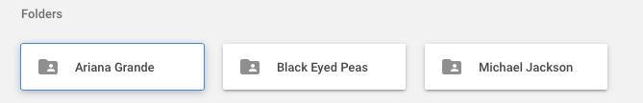
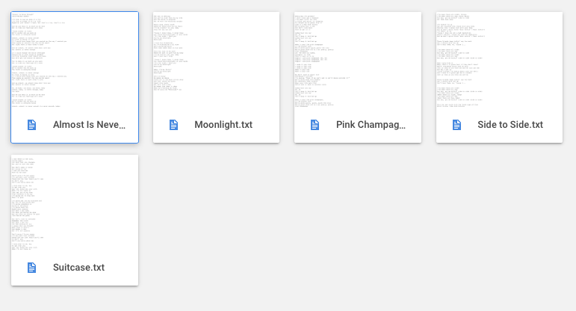
Song Lyrics
Within each category, there will be at least 3 artists. For the dataset we selected at least 5 songs from each artist.

Slide 33
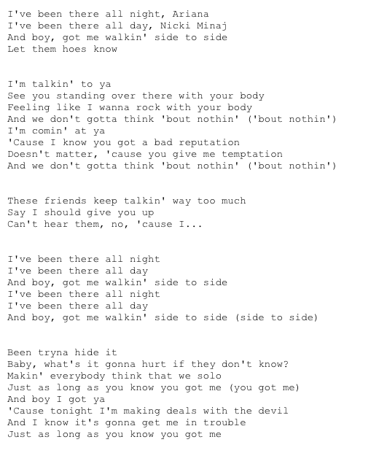
Each song will have the lyrics captured in a .txt file for cleaning and analysis, and stored locally.

Slide 34
DEMONSTRATION

Slide 35
CONCLUSION
With Natural Language Processing and NLTK library, our program is capable of parsing and analyzing songs lyrics, in order to identify curse words and rate the songs as appropriate or inappropriate for children and teenagers.
Using Natural Language Processing, the machine can warn parents or school teachers about the song, and give a classification of it.
Natural Language Processing allows the computer understand what we are telling them.

Slide 36
NEXT STEPS
Further implementations involves:
Analyzing all songs at the same time and rank those songs from General to Restricted (G - PG13 - R)
Create your own playlist with appropriate songs for each range of age
Analyze the sentiment and feelings on each song (Natural Language Processing and Natural Language Understanding)
Notes:
Ranking songs
Playlist creation
Sentiment analysis

Slide 37
Sources & Links
http://www.contrib.andrew.cmu.edu/~amera/nlp_Page.html
https://nlp.stanford.edu/~wcmac/#papers
https://blog.algorithmia.com/introduction-natural-language-processing-nlp/
NLP Libraries:
https://opennlp.apache.org/
http://mallet.cs.umass.edu/index.php
https://stanfordnlp.github.io/CoreNLP/
http://www.nltk.org/
https://textblob.readthedocs.io/en/dev/index.html
https://radimrehurek.com/gensim/

